Slide 1
Chapter 5 The Expectation Hypothesis
資管所 周立軒、謝昌宏
指導老師：戴天時 教授

Slide 2
Outline
5.1: Motivation
5.2: The Present Value Form
5.3: Unbiased Forward Rate Form
5.4: Relation between the two versions of the expectations hypothesis
5.5: Empirical illustration

Slide 3
5.1 Motivation
There are more than one expectation hypothesis
In this chapter, there are two expectation
The first hypothesis makes us calculate present value easily
The second hypothesis makes us predict future spot rate using the forward rate

Slide 4
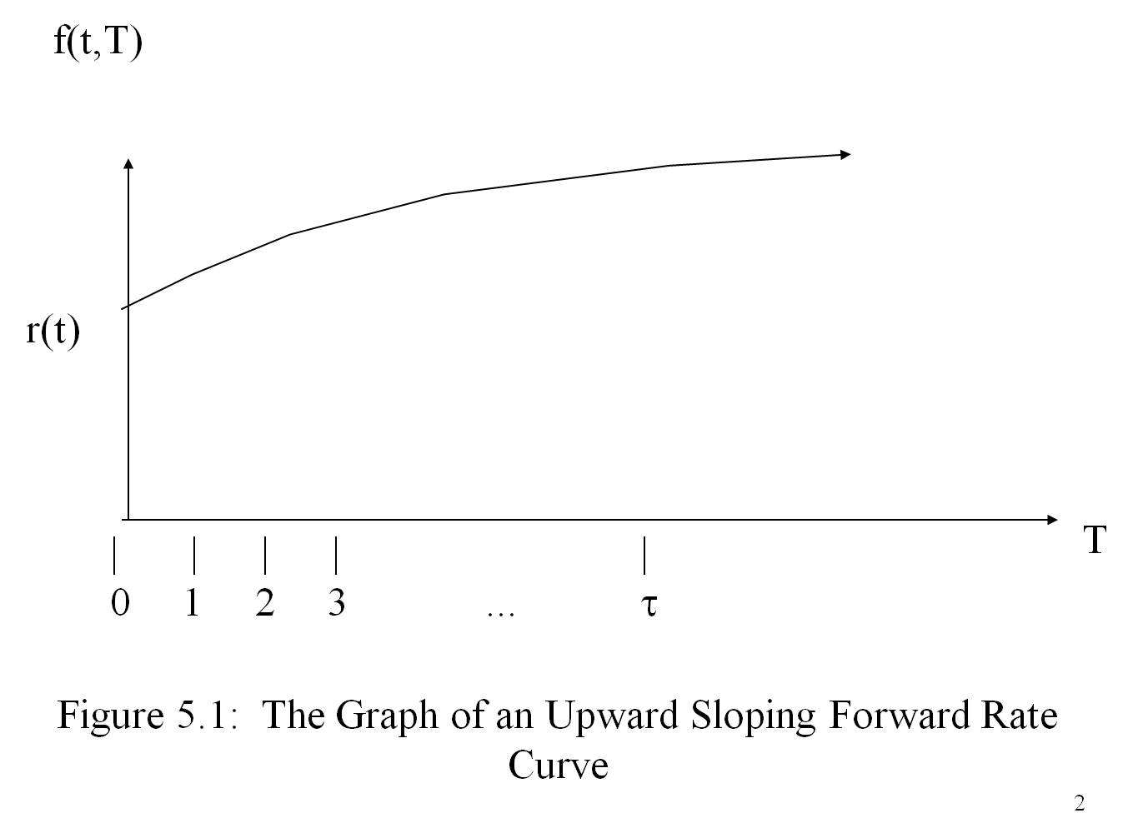
5.1 Motivation

Slide 5
5.1 Motivation
Figure 5.1 shows that forward rate curve can be used to predict future spot rate
But, in fact, these two hypothesis are not true
The modified version is practically used, and later chapter

Slide 6
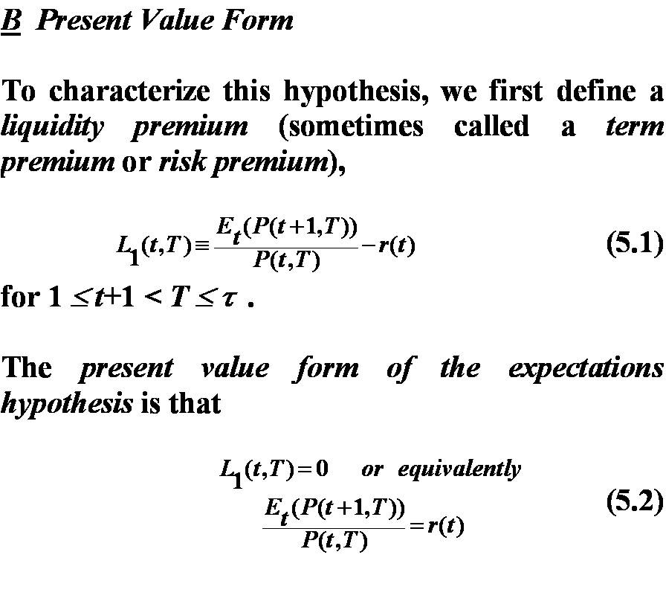
5.2 Present Value Form
The first motivation is related to the returns on zero-coupon bonds on different maturities.
Define Risk Premium:

Slide 7
5.2 Present Value Form
stands for the expected value in time t.
P( t, T) stands for the price of the T-maturity zero-coupon bond observed on time t.
r(t) stands for the spot rate on time t.

Slide 8
5.2 Present Value Form
Risk Premium represents the excess return above the spot rate.
In the theory of investment, it’s normally believed traders are risk-averse. And the riskier the investment , the higher the expected return must be to induce traders to hold it.

Slide 9
5.2 Present Value Form
Also, if investors are risk-neutral, they don’t care about risk; they care only about the expected return.
In an equilibrium economy consisting only risk-neutral investors, the excess return must be zero.
Proof:
If there are two assets had different expected return, the one has highest expected return will be desired for all investors, and the other will be shunned.
Supply don’t equal to demand, this situation could not be an equilibrium.

Slide 10
5.2 Present Value Form
Because the expectation hypothesis is consistent with risk-neutral economy. Hence, we obtain the following result:

Slide 11
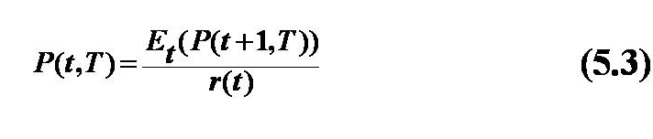
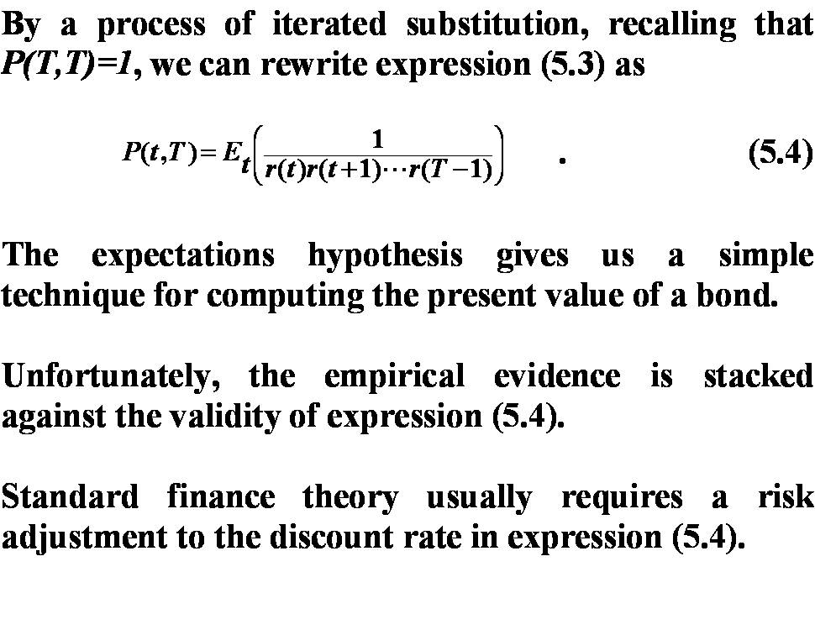
5.2 Present Value Form
The second motivation can be obtained by rewriting the expression (5.2):
By the iteration process, and recalled P(T,T) = 1, we obtain:

Slide 12
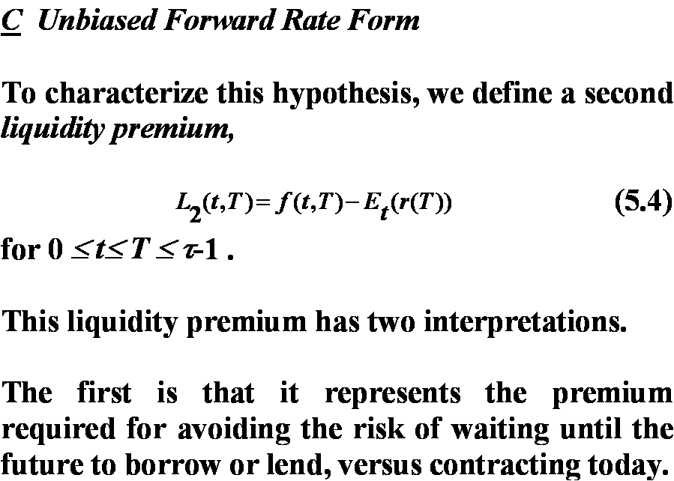
5.3 Unbiased Forward Rate Form
This second version of the expectation hypothesis involves the different maturities forward rates.
Define the second risk premium:

Slide 13
5.3 Unbiased Forward Rate Form
Expression (5.4) is the difference between the forward rate at time t for date T and the expected spot rate for date T
There are two interpretations

Slide 14
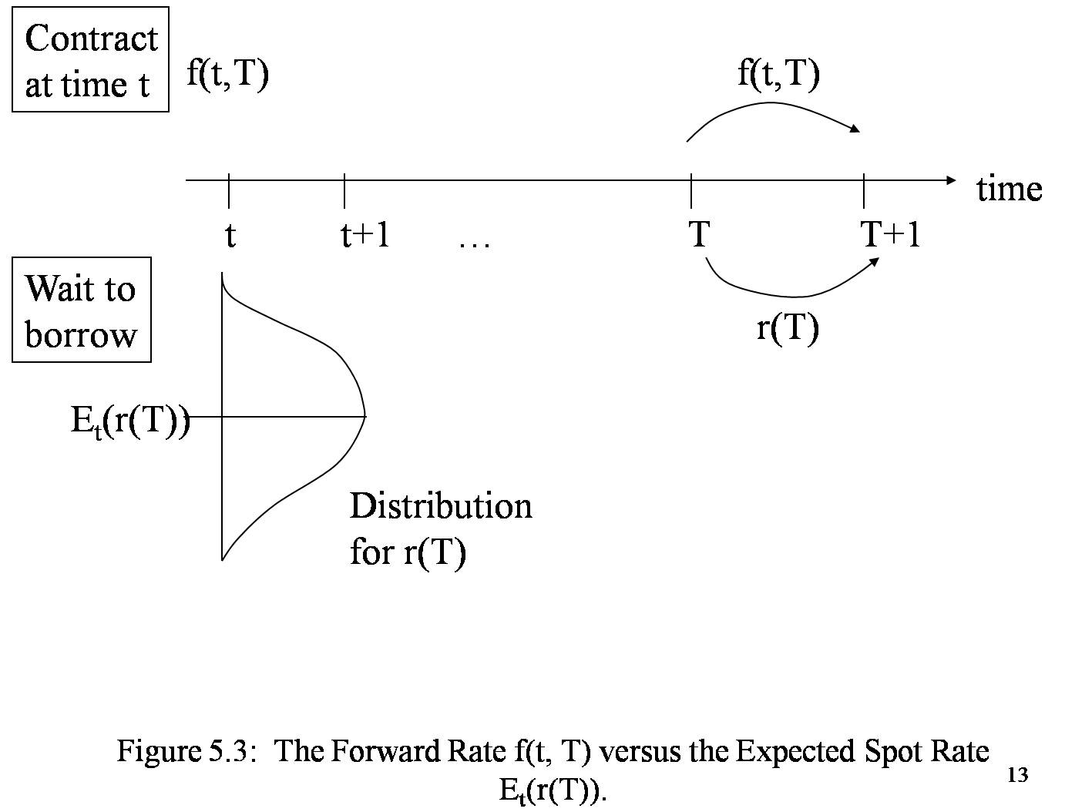
5.3 Unbiased Forward Rate Form

Slide 15
5.3 Unbiased Forward Rate Form
Supposed we stand at time t and want to borrow funds at future date , time T. We have two way to do so:
1. Wait until time T to borrow. We will borrow at the spot rate r(T). But now we only can predict r(T) according to the probability distribution. The most possible r(T) we can borrow at is E_{t}(r(T))
2. We now borrow at the future rate f(t,T)
So, the first interpretation to expression (5.4) is the premium one is willing to pay to avoid the risk of waiting to borrow.

Slide 16
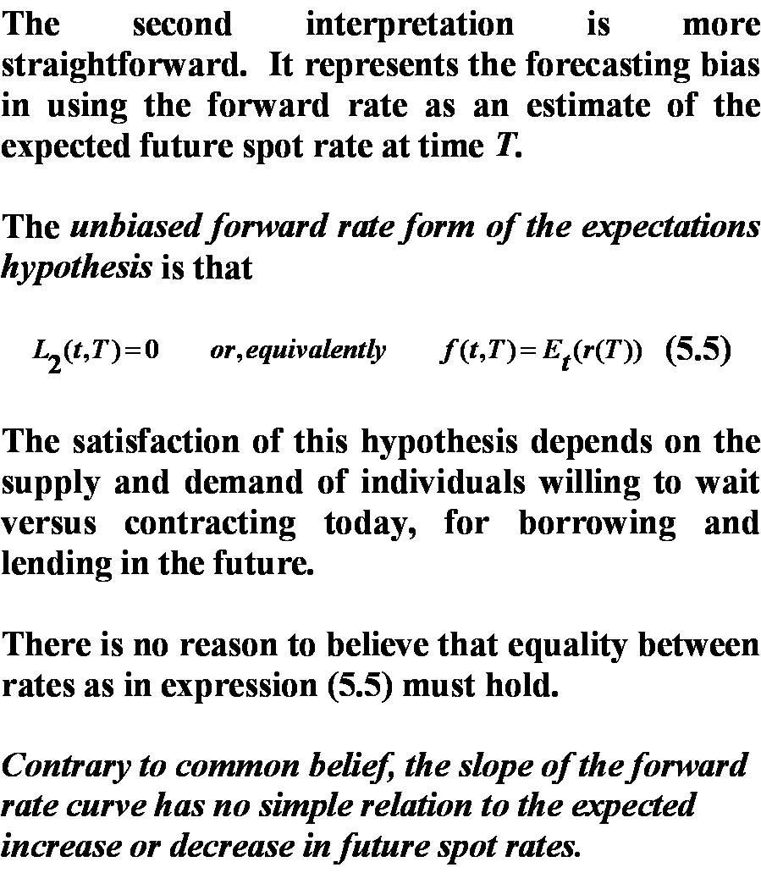
5.3 Unbiased Forward Rate Form
The second interpretation is more simple. It uses forward rate as the estimator to measure the bias of expected spot rate at time T.
The unbiased forward rate form for expectations hypothesis is:

Slide 17
5.3 Unbiased Forward Rate Form
The evidence is inconsistent with the hypothesis.
The satisfaction of this hypothesis depends on many factors, such as the supply and demand of willing to borrow at time T or now, availabilities of funds, risk aversion……

Slide 18
5.3 Unbiased Forward Rate Form
Traders commonly believe the forward rate curve can predict the future spot rate
See example below

Slide 19
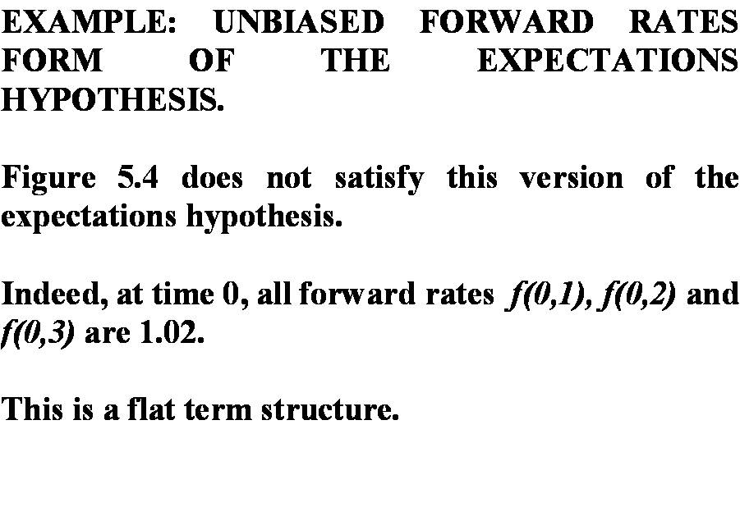
5.3 Unbiased Forward Rate Form

Slide 20
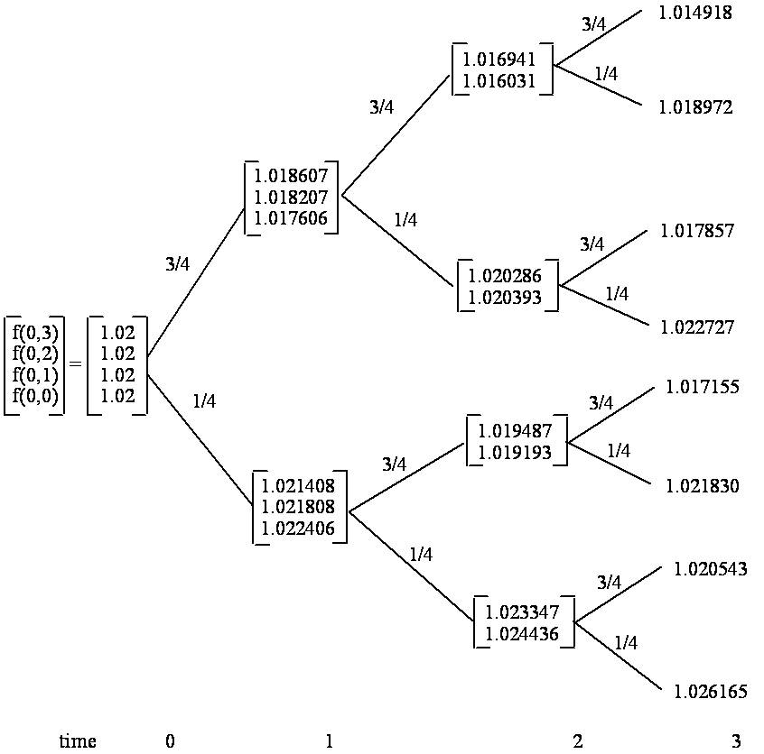
5.3 Unbiased Forward Rate Form

Slide 21
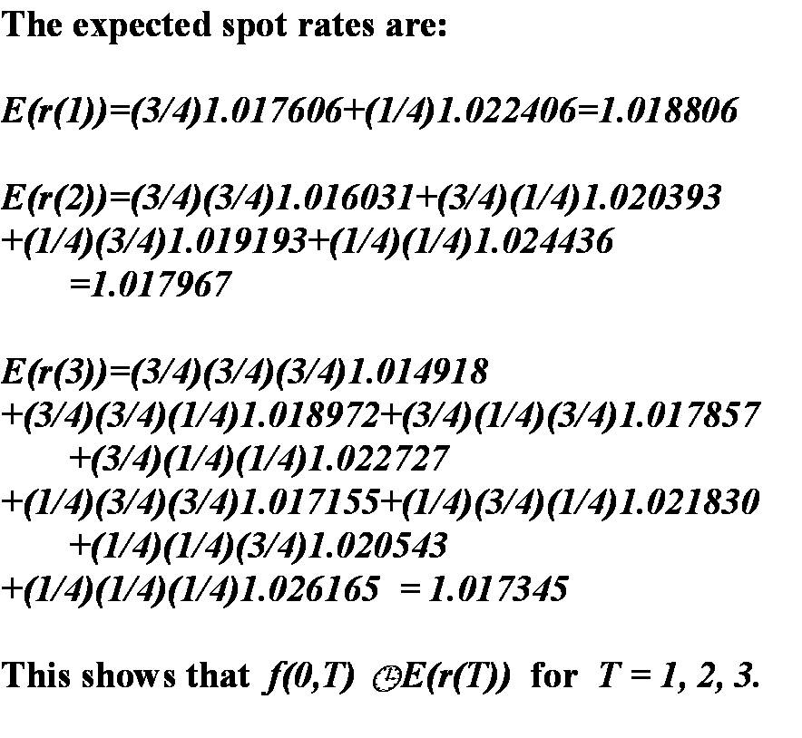
5.3 Unbiased Forward Rate Form

